Slide 1
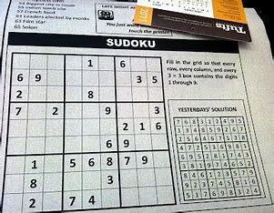
SUDOKU SOLVER
SAHIL SINHA
A45605221020

Slide 2
What is sudoku ?
Sudoku is a fun number puzzle, based on logic, that consists of a 9x9 grid of small squares to be filled with numbers. The puzzle is highlighted by nine 3x3 subgrids.
Sudoku puzzles will be printed with some cells already filled with numbers, and some cells are not pre filled.

Slide 3
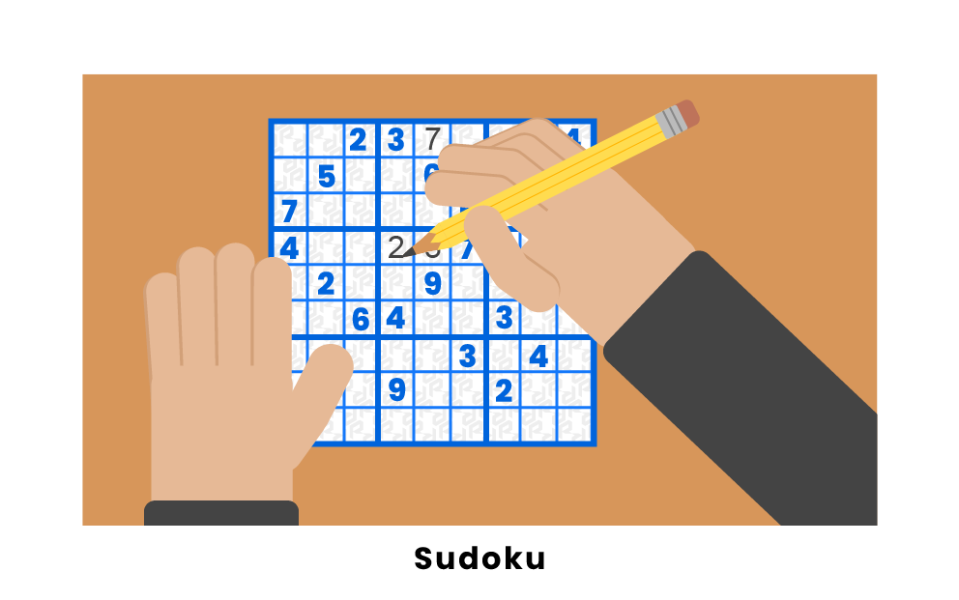
How to solve sudoku?

Slide 4
3 rules to solve sudoku
1. Each and Every row should contains all numbers from 1 to 9 without repetition of any number.
2. Each and Every column should contains all numbers from 1 to 9 without repetition of any number.
3. Each 3x3 matrix should contains all numbers from 1 to 9 without repetition of any number.

Slide 5
PROGRAM TO SOLVE SUDOKU

Slide 6
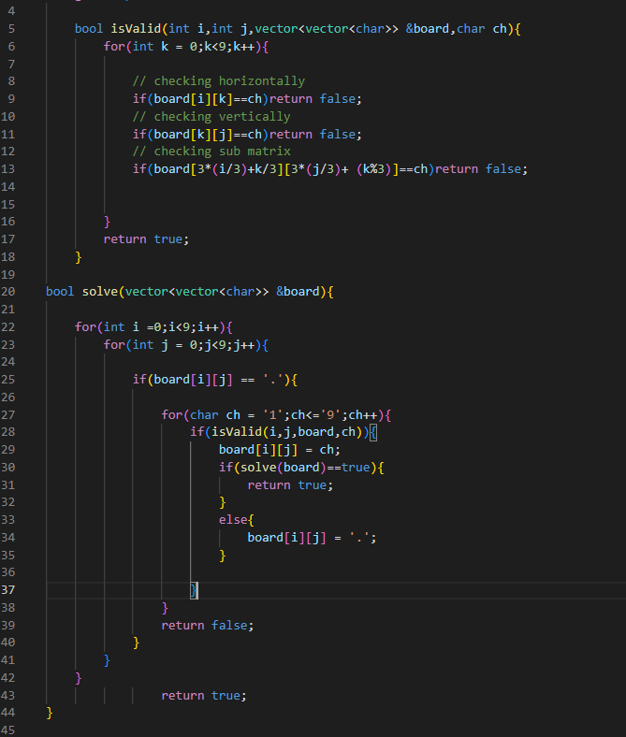

Slide 7
INPUT AND OUTPUT

Slide 8
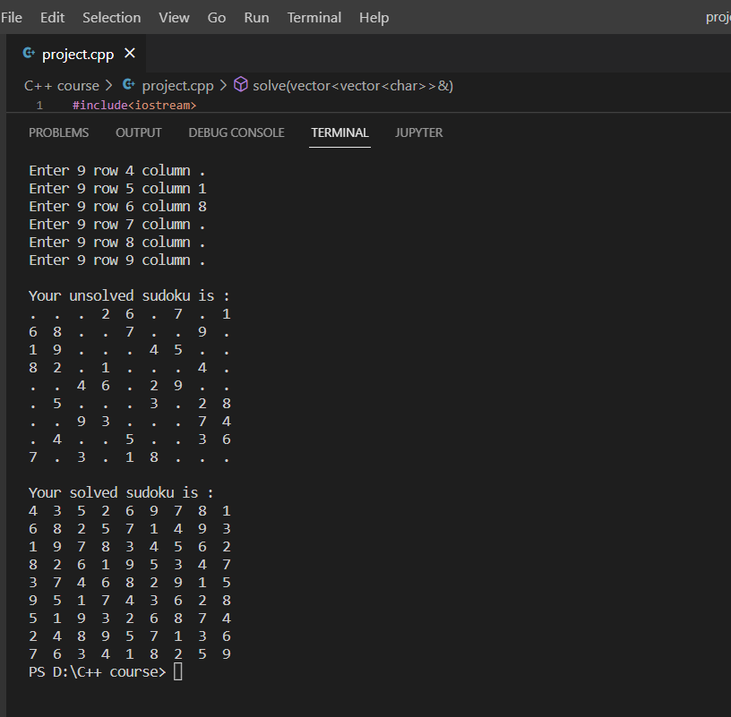

Slide 9
THANK YOU

